Slide 1

SOFTWARE ENGINEERING CSE-3001
J-COMPONENT PROJECT REPORT
TOPIC:Risk Management Tool
SUBMITTED BY:
Gunik Luthra (19BCE2285) Anshul Anand (19BCI0065)
K Sam Sathya Narayanan
(19BCI0233)

Slide 2
ACKNOWLEDGEMENT
First of all, we are feeling oblige in taking the opportunity to sincerely thanks to honorable G.Viswanathan (Founder-Chancellor, VIT University). Next we would like to thank Dr. Saravanan R(DEAN, School of Computer Science and Engineering) and special thanks to Dr. Vairamuthu S (Head of Department, School of Computer Science and Engineering)
Last but definitely not the least; we would like to express our special thanks of gratitude to our Software Engineering faculty, Dr. Swathi J N, who gave us the golden opportunity to do this wonderful project on the topic "Risk Management Tool". Any attempt at any level can't be satisfactorily completed without their friendly behavior and generous attitude, thus we are really grateful to all of them. We are overwhelmed in all humbleness and gratefulness to acknowledge our depth to all those who have helped us to put these ideas, well above the level of simplicity and into something concrete.

Slide 3
EXECUTIVE SUMMARY
The Risk Management Tool is designed as an aid in the process of risk management. Main functionalities of the application include the ability to keep a register of identified risks for multiple projects. Each of register entries - 'risks' - can be described by the user with its qualitative and quantitative properties, making the process of risk evaluation easier and providing a valuable insight for planning risk response. Managing risk responses is also one of the tool's functionalities, allowing user to keep a risk response plans for each of risk register entries.

Slide 4
TABLE OF CONTENTS
S.NO. | TOPIC | PG.NO.
1 | ACNOWLEDGEMENT | 2
2 | EXECUTIVE SUMMARY | 3
3 | LIST OF FIGURES | 5
4 | LIST TABLES | 6
5 | INTRODUCTION | 8
6 | PROJECT DESCRIPTION AND GOALS | 9-10
7 | TECHNICAL SPECIFICATIONS | 11-14
8 | DESIGN APPROACH AND DETAILS | 15-32
9 | SCHEDULE,TASK AND MILESTONES | 33-34
10 | PROJECT DEMONSTRATIONS | 35-38
11 | RESULT | 39

Slide 5
LIST OF FIGURES
S.NO | Figure | PG.NO
1. | WORK BREAKDOWN STRUCTURE | 10
2. | Design approach | 15-17
3. | Use Case Diagram | 18
4. | Data flow diagram | 18-19
5. | Class diagram | 19
6. | State Transition diagram | 20
7. | ER Diagram | 20
8. | Sequence and collaborative | 21-28
9. | Code and standards | 29-31
10. | Gantt chart | 33
11. | Timeline chart | 33
12. | Activity chart | 34

Slide 6
LIST OF TABLES
S.NO | Table | PG.NO
1 | Stimulus Response | 11-12
2 | Performance Requirements | 13
3 | shall requirements | 32
4 | Design constraints | 32-33
ABBREVIATIONS

Slide 7
SRS
SOFTWARE REQUIREMENT SPECIFICATION
SDS
SOFTWARE DESIGN SPECIFICATION

Slide 8
INTRODUCTION
1.1 OBJECTIVE
The objective of this project is to provide a web based platform to carry out the risk management process and its various functions and storing the details in the database.
MOTIVATION
Risk management is one of the most necessary things in a project and is required by every company or team carrying out a particular project so our team thought of building a project which would allow the users to allocate the risks according to their need of the work they are doing which would in return ease the progress of any project.
BACKGROUND
Good planning is the bedrock of every successful software development project. However, the Covid-19 pandemic has made planning and collaboration harder since people cannot physically meet each other and have to do almost everything online.
“Risk management project” was built by us with the aim to
provide an effective website which would allow the users to easily allocate the risk and work on it for further ease of carrying out a project.

Slide 9
PROJECT DESCRIPTION AND GOALS
The Risk management software that has to be developed is not a complete risk avoiding software itself. The risk management software and its requirements are only pertaining to the functionality needed to implement the risk management software.
Specifically, the risk management software extends the current risk manoeuvring services. So, it is going to task the methods of avoiding the risk and the procedures to be followed by categorizing the risks on the basis of software that we are going to build. The Risk Management Tool is designed as an aid in the process of risk management.
2.1 GOALS
Main functionalities of the application include the ability to keep a register of identified risks for multiple projects. They allow the uncertainty to be addressed by identifying and generating metrics, parameterizing, prioritizing, and developing responses, and tracking risk. Each of register entries - 'risks' - can be described by the user with its qualitative and quantitative properties, making the process of risk evaluation easier and providing a valuable insight for planning risk response. Managing risk responses is also one of the tool's functionalities, allowing user to keep a risk response plans for each of risk register entries.

Slide 10
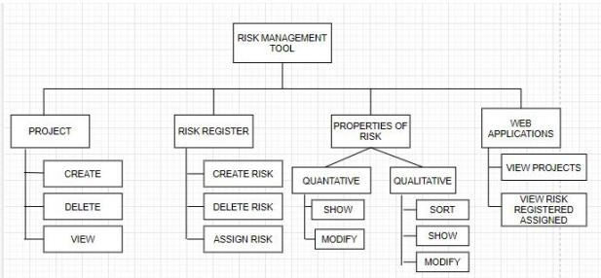
2.2 WORK BREAKDOWN STRUCTURE
2.3 PROCESS MODEL
We are using the WaterFall model for the project because all the requirements for the project are understood.It is difficult to run processes in parallel and no daily updates are needed.

Slide 11
TECHNICAL SPECIFICATIONS 3.1 System Features 3.1.1Login 3.1.1.1Introduction The risk management software shall allow a user to login into the server which will provide the instructions for the risk management and allow them to login into the page using their mail id and password Functional Requirements Purpose: creating a new account or login into an existing one Input: Name, mail id, contact, password Processing: new entry will be made in the database Output: the account will be created or the user will be logged into the created account and then they can access a project or edit them. Stimulus Response A) user wants to create a account
User Actions | System Actions
(1) clicks on create a new account
 | (2) form asking the details of the user
(3) all fields are filled in by the user and signup button is clicked
 | (4) system updates the database regarding the new creation
 | (5) user is redirected to the login page

Slide 12
B) User wants to login to existing account
User Actions | System Actions
(1) click on login
 | (2) form asking about the login details
(3) all fields regarding the login details are filled
 | (4) system takes the account to the allocated database
 | (5) user is redirected to the home page
Locating project Introduction The software will take u to the locating page where u have to type in specific fields to find the particular projects Functional Requirements Purpose: for locating a specific project in a database Input: Project Id, Project name Processing: will be able to traverse around the database for finding a project Output: will be taken to the particular project requested for Stimulus Response
User Actions | System Actions
(1) enter project id
(2) enter project name
(3) enter project description
 | (4) will be redirected to the particular project requested by the user
 | (5) the particular project page pops up

Slide 13
Creating or deleting the project Introduction This feature allows the user to create a particular project or allows them to edit it or delete it Functional Requirements Purpose: for creation or deletion of the project Input: name, description, id, risk register Processing: If project requires some editing the system will do it or it will create a new project Output: new project is created or edited and is now available for use Stimulus Response A) Reply to a Stamped Email (with stamp logged for Return Use.)
User Actions | System Actions
(1) type the name
(2) type the description
(3) type the id
(4)type the risk register
(5) Compose/Edit Email
(6) Initiate the save
 | (7) the project gets registered and will be saved in the database

Slide 14
3.2Performance Requirements The following tables list the performance requirements of the for risk management software. Table of Performance Requirements
Performance Requirement | Description
Database storage capacity | the database storage capacity for the projects
Software Runtime Errors | The risk management software will handle the runtime errors consistently and as gracefully as possible.

Slide 15
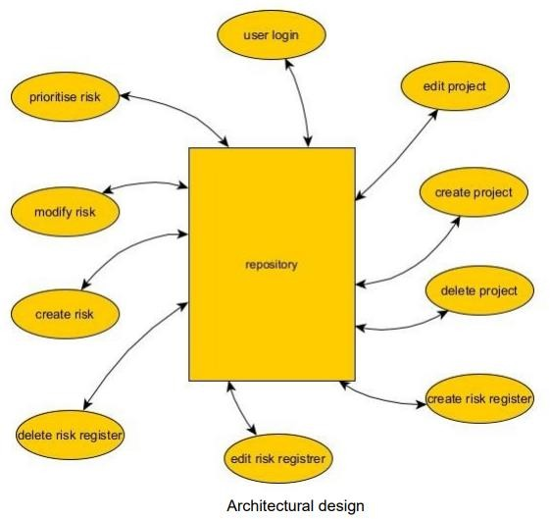
DESIGN APPROACH AND DETAILS
Design approach
architectural design

Slide 16
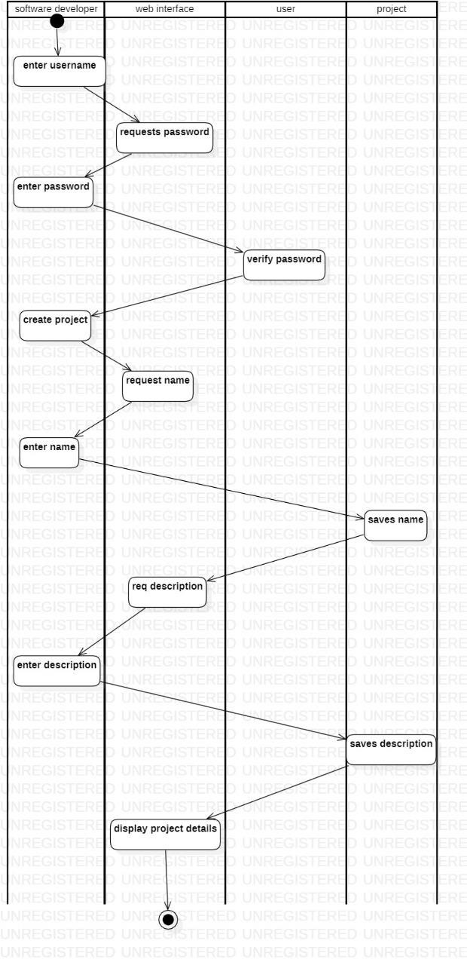
4.1.2 activity diagram

Slide 17
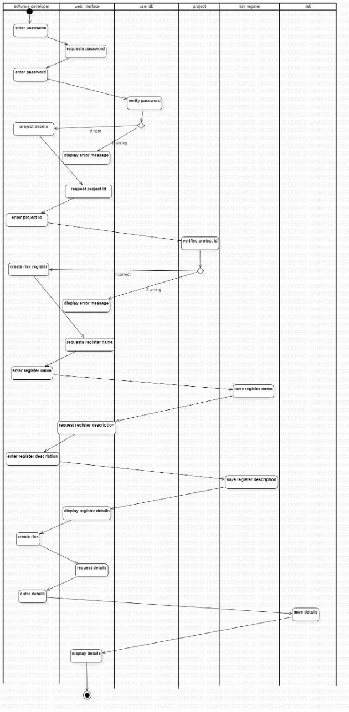
2

Slide 18
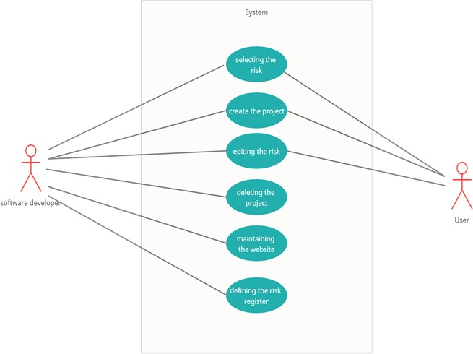
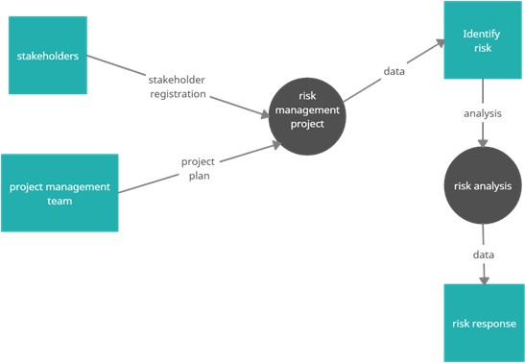
4.1.3 use case diagram
4.1.4 Data Flow diagram

Slide 19
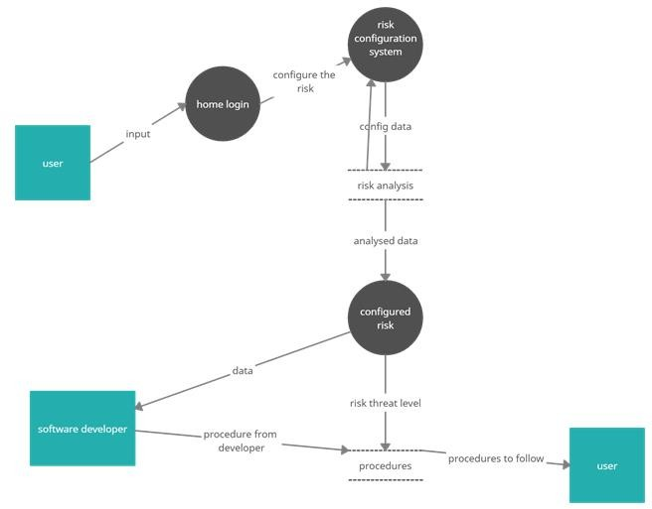
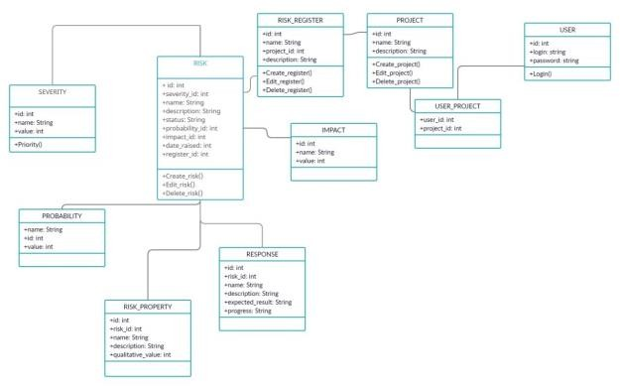
4.1.5 class diagram

Slide 20
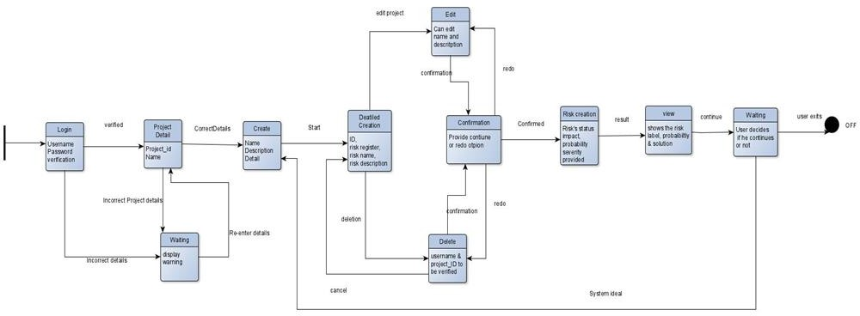
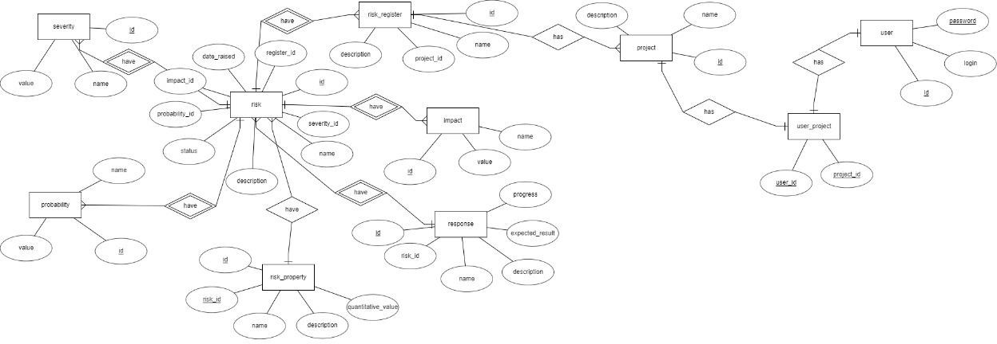
4.1.6 state transition diagram
4.1.7 ER diagram

Slide 21
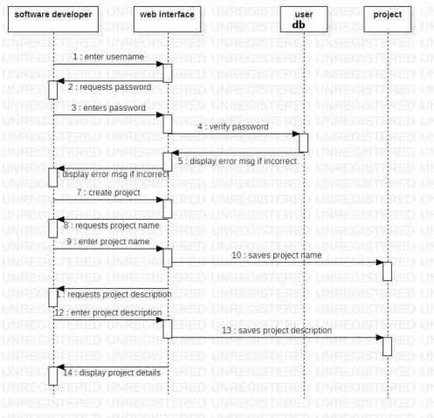
sequence and collaboration diagram
create project

Slide 22
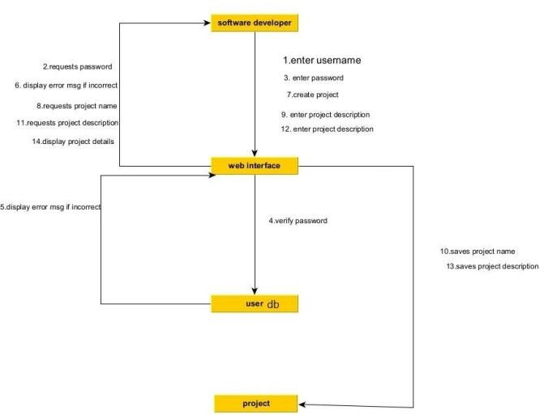
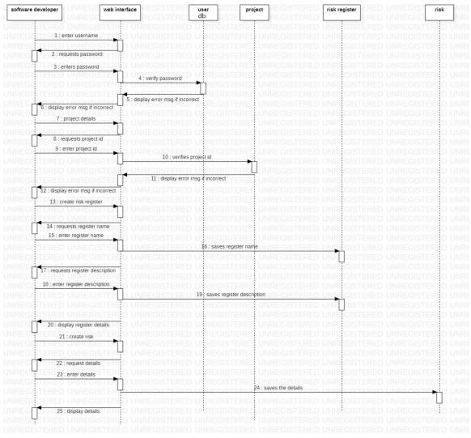
4.1.8.2 defining risk register

Slide 23
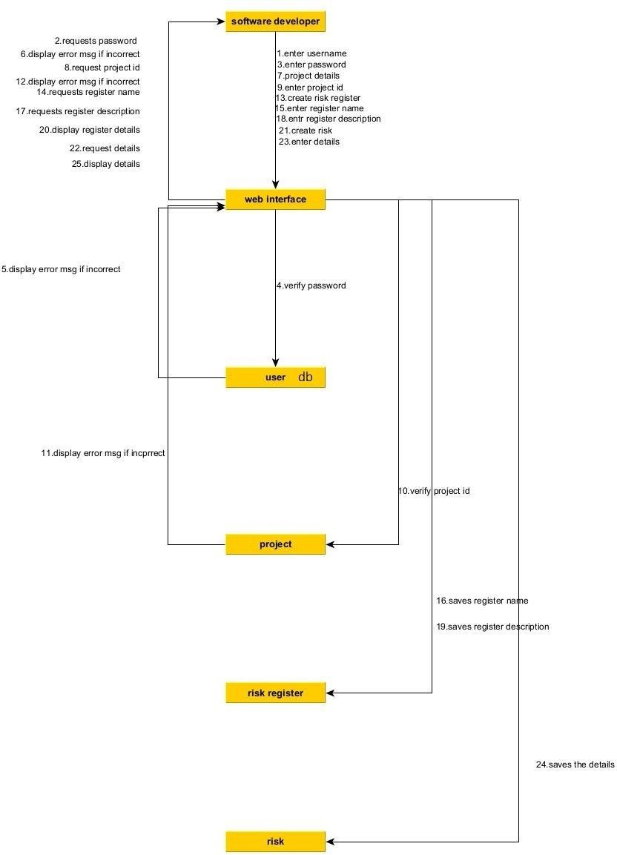

Slide 24
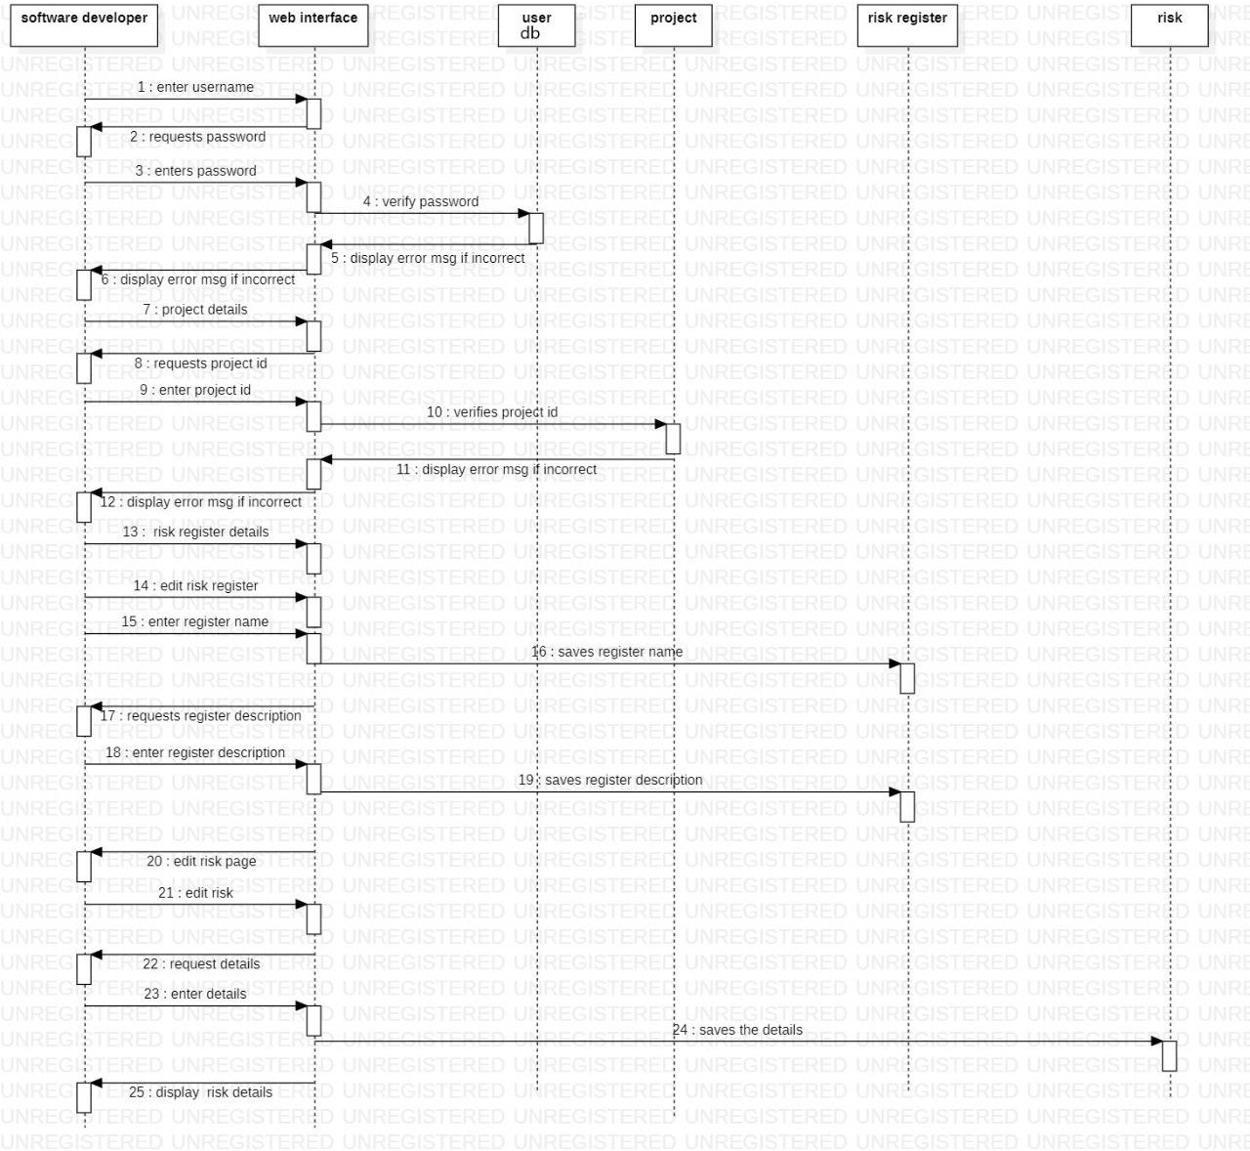
4.1.8.3 editing risk register

Slide 25
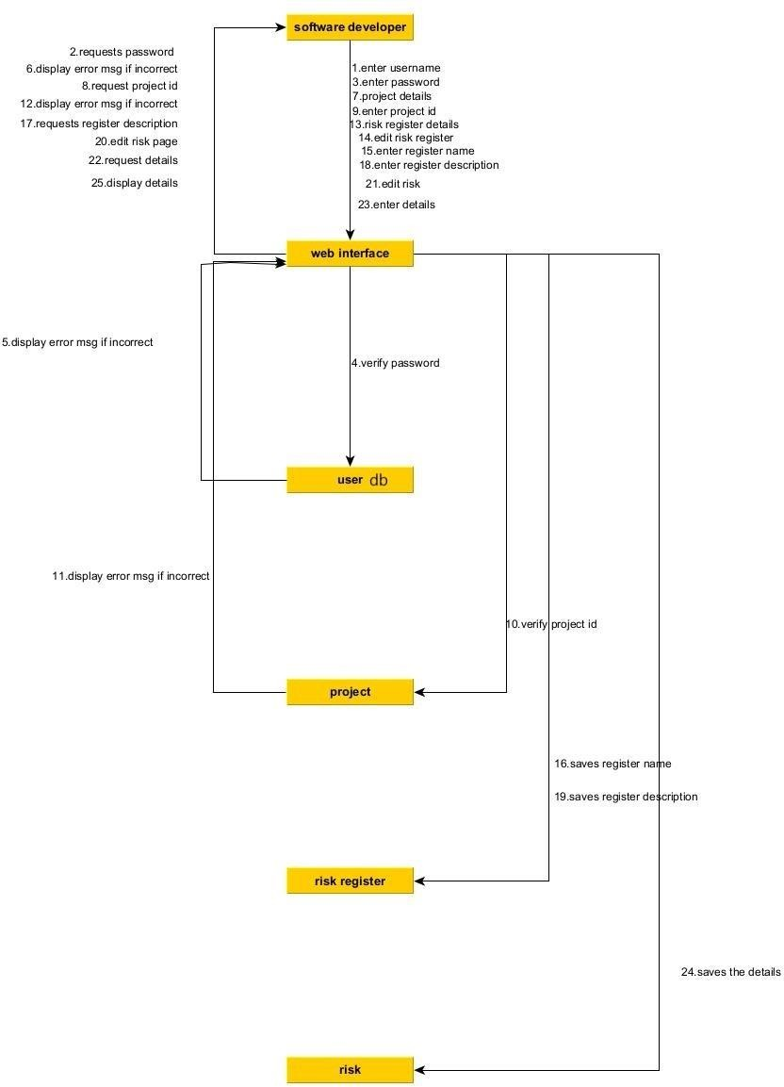

Slide 26
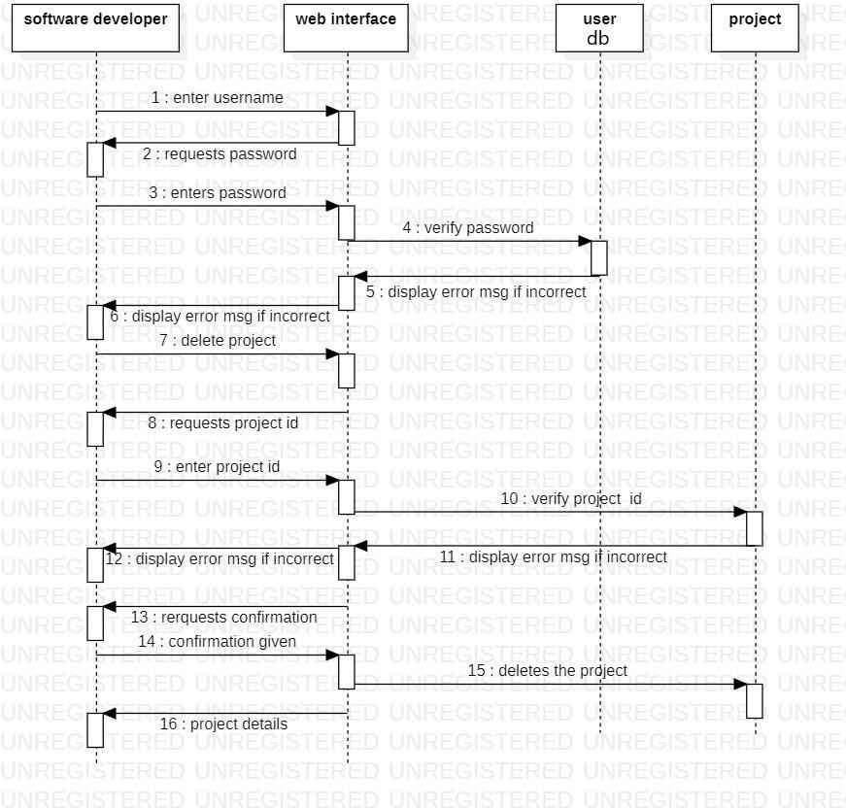
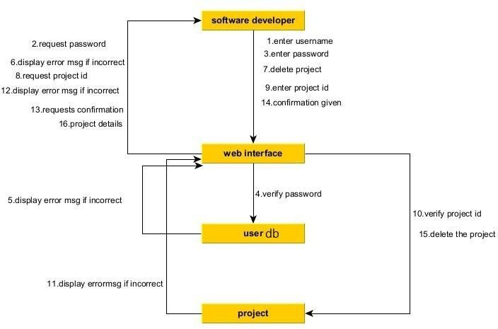
4.1.8.4 delete project detailed design

Slide 27
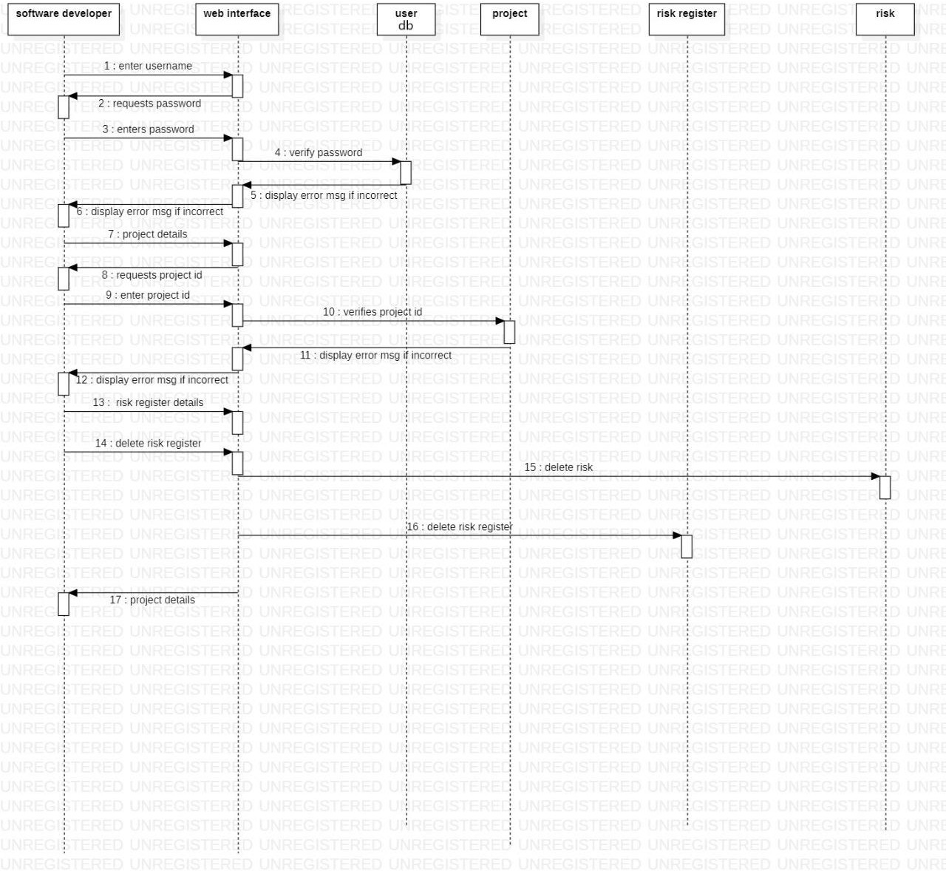
4.1.8.5 delete risk detailed design

Slide 28
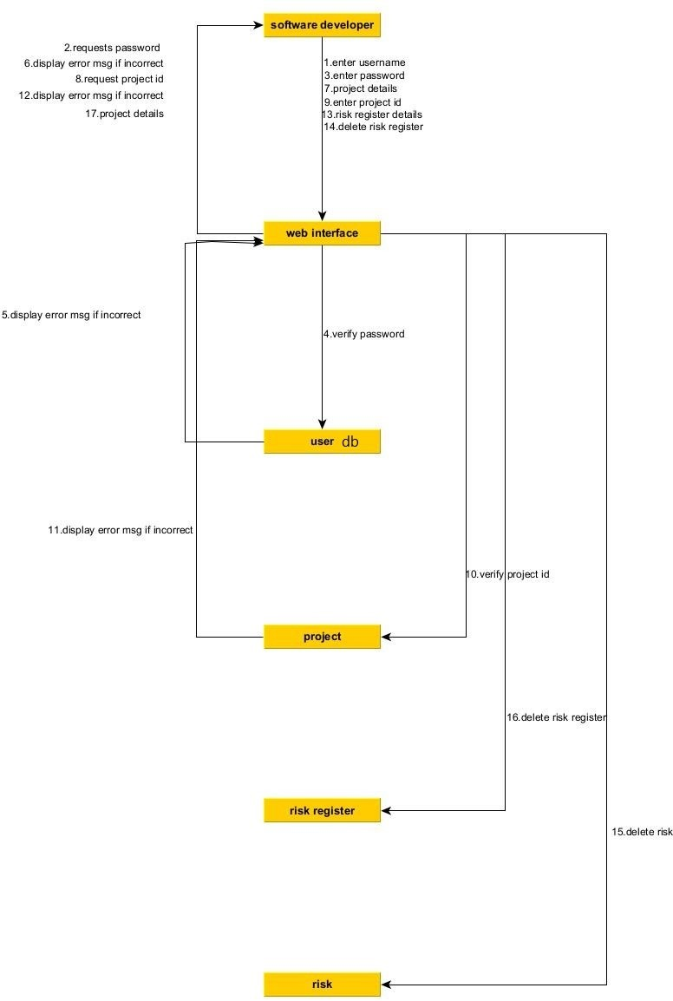

Slide 29
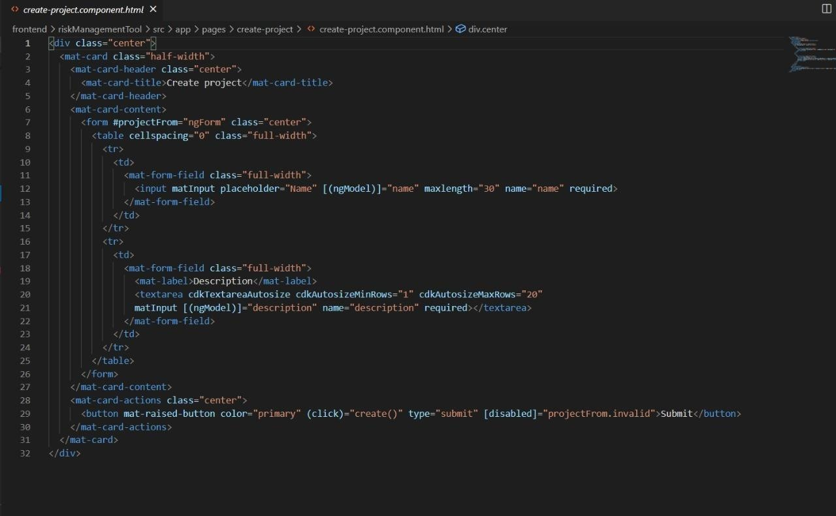
4.2 Codes and standards
A coding standard gives a uniform appearance to codes written by different team members.
It improves the understanding and complexity of the code.
create project html

Slide 30
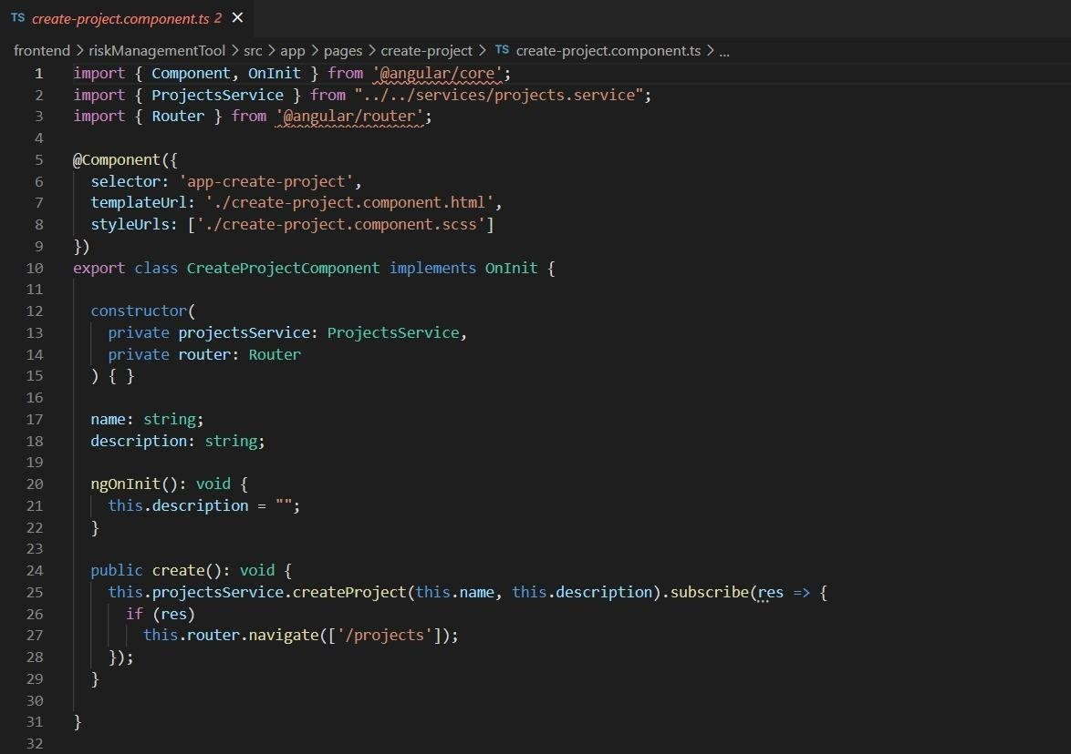
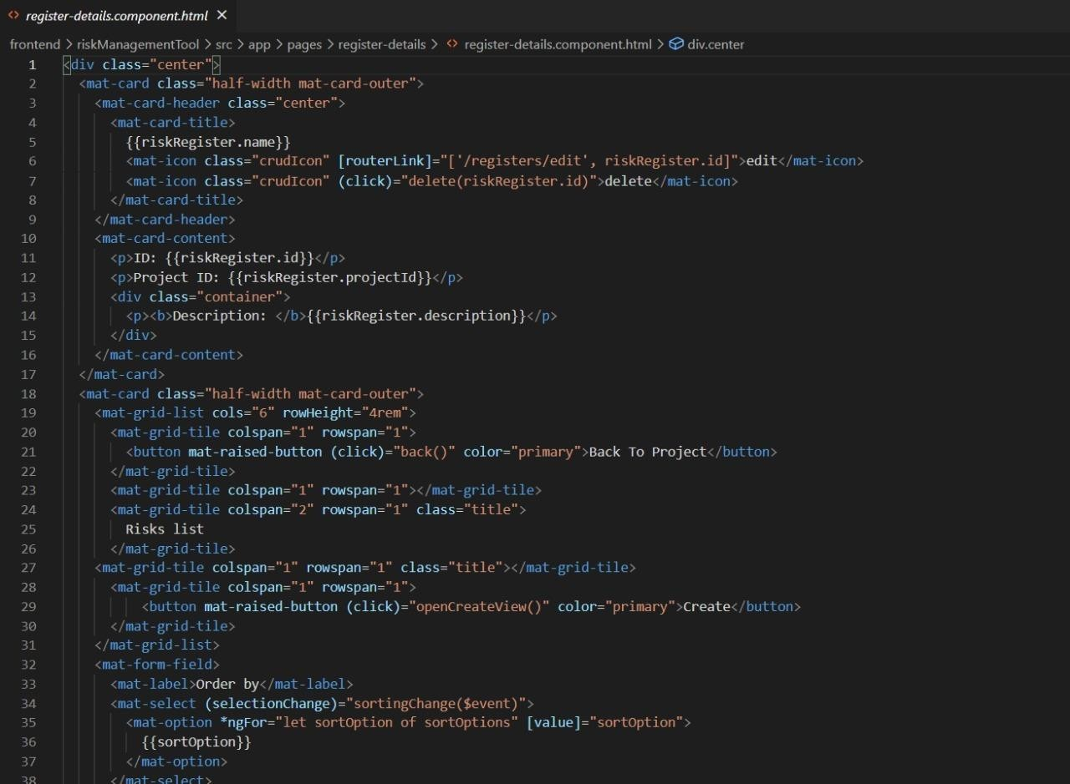
create project ts
register details html

Slide 31
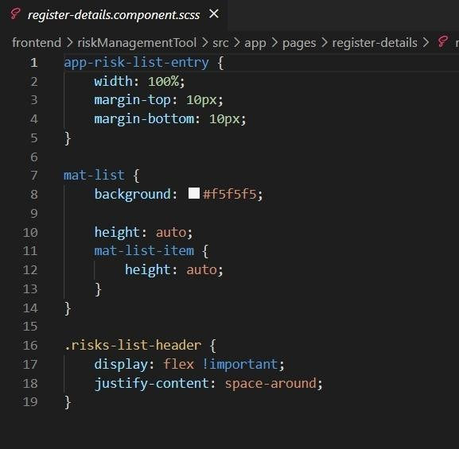
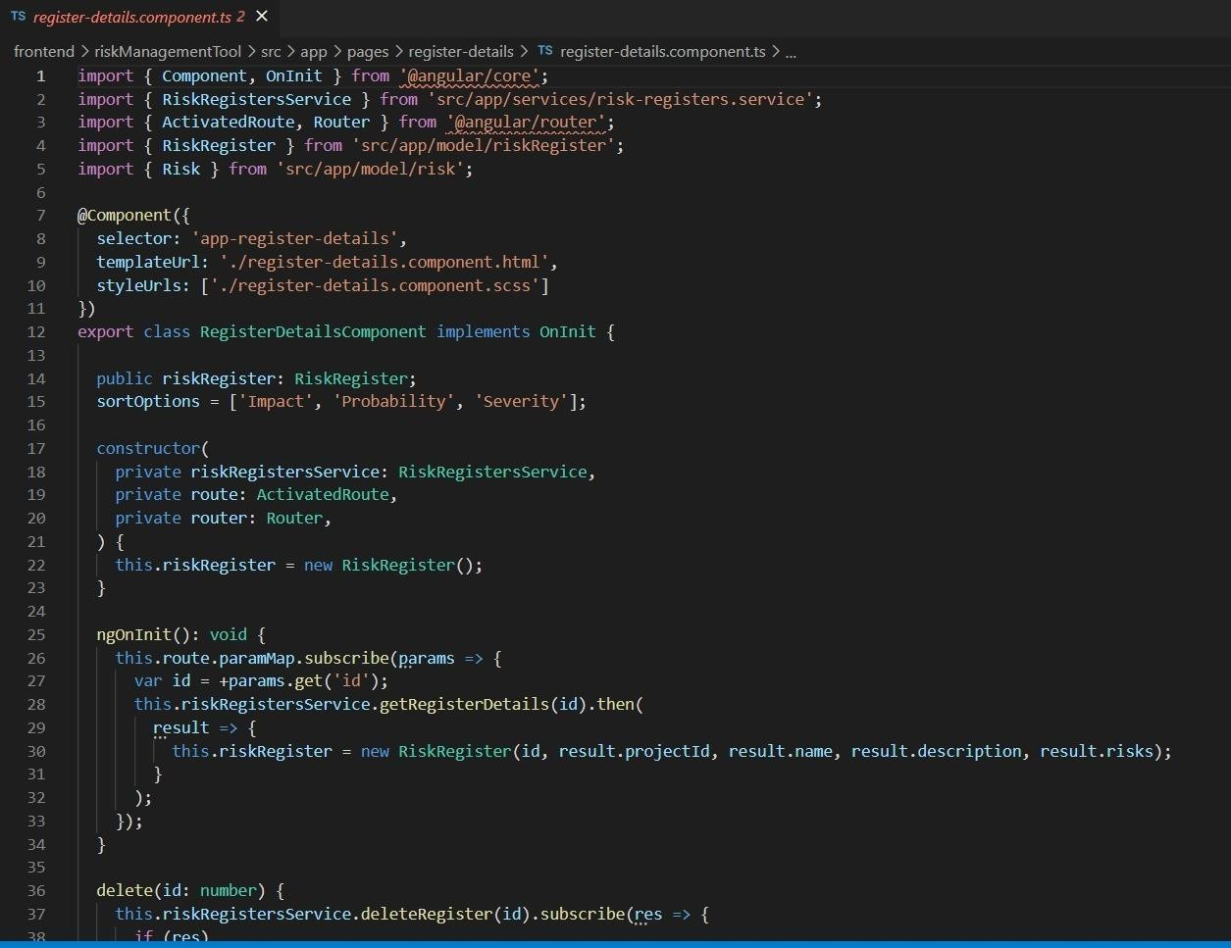
register details css
register details ts

Slide 32
Constraints,Altrnatives and Tradeoffs shall requirements
ID | Origin | Shall Requirement
1 | Software developer | The developer SHALL be able to identify the type the risk
2 | Software developer | The software developer SHALL be able to identify the type of risk and forward it.
3 | Software developer | The identified risk shall be categorically listed.
4 | Software developer | A developer SHALL be able to edit the project.
5 | Software developer | The developer SHALL be able to send instructions to be taken by the software.
6 | Software developer | The developer SHALL be able to create projects and add to its description
7 | Software developer | The developer SHALL be able to enter the details of the particular risk and act upon that
8 | Software developer | The User SHALL be able to identify the risks and SHALL be able to take the procedures in action and also be able to edit the risk presented in front of him
4.3.2 design constraints
ID | Origin |  | Shall Requirement
1 | User |  | A user shall be able to login to the software without any issues.
2 | Software developer |  | The maintainability of the software SHALL be easy and short in duration of time.
3 | Software developer |  | The usage of the risk management software should be significant enough that the authorities would buy it in future.
4 | Software developer |  | The software developer shall be able to edit and delete the projects when needed or the necessity arises.
5 | Software developer |  | The developer SHALL be able to move freely through the software as of when needed after getting authentication from the users.
6 | Software developer |  | The system SHALL have both online and offline system both.
7 | Software developer |  | The system SHALL require enough disk storage
8 | Software developer |  | The software shall require specific OS which would be Windows OS above XP
9 | Software developer |  | The system SHALL at least have a total memory of 1 gb or above
10 | Software developer |  | The system SHALL not restrict the user from editing the projects.
11 | Software developer |  | The system SHALL filter the risks entered by the user
12 | Software developer |  | The system SHALL allow the user to receive SOS alerts when the risk is higher.
13 | Software developer |  | The system SHALL allow the developer to respond to the users queries and the project he puts up in the particular software.

Slide 33
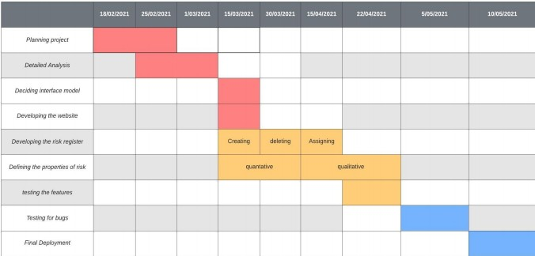
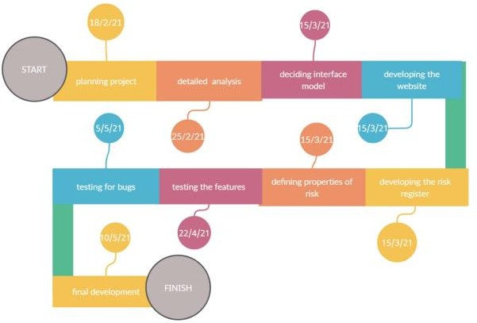
ID | Origin | Shall Requirement
14 | Software developer | The system SHALL allow the developer and user to have a indeterminate exchange of emails and voice messages between the two regarding the projects
15 | Software developer | The system SHALL allow the developer to create new projects with details.
SCHEDULE,TASKS AND MILESTONES Gantt chart Timeline Chart

Slide 34
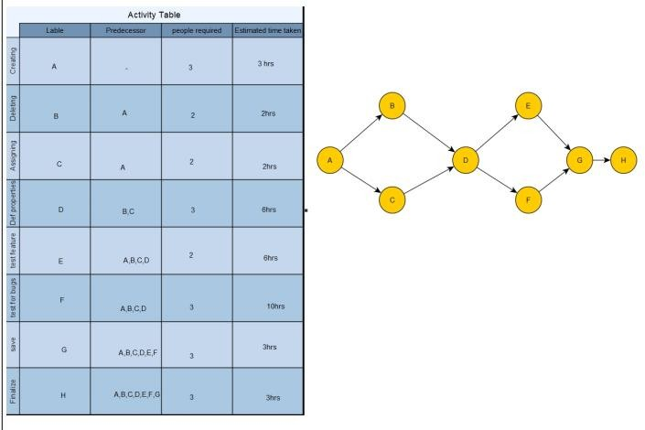
5.3 activity chart

Slide 35
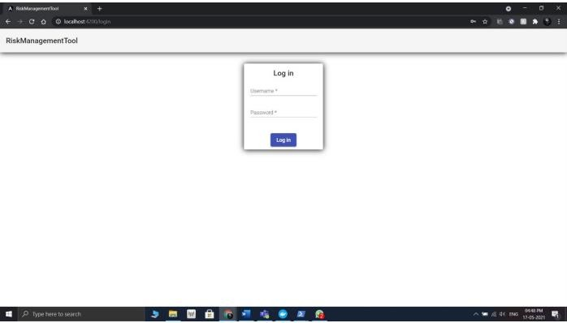
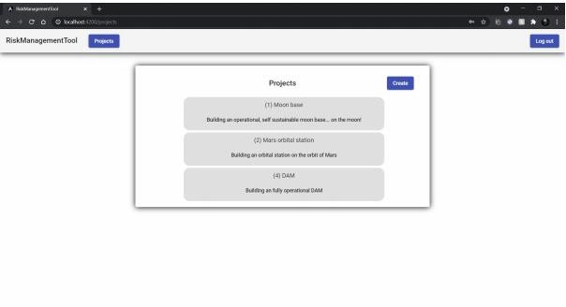
PROJECT DEMONSTRATION
6.1) Login Page: -
Description
The risk management login User Interface can be accessed via the main. The UI in figure above allows the user to provide information regarding login procedures. In figure above the user provides the name and password.
6.2) Project Page: -
Description

Slide 36
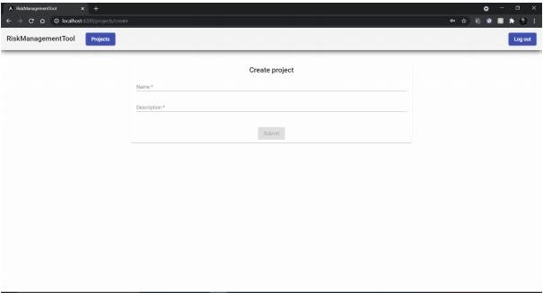
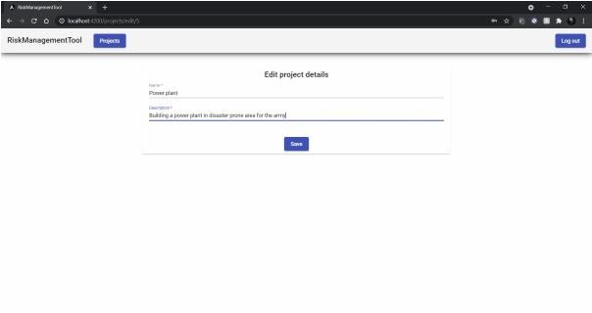
This figure represents the home page of the project where you can access all the projects or go into the creation menu as suggested in the right-hand side of the projects tab.
6.3) Create Project Page: -
Description
The following figure indicates the page for creation of the project where the user can enter the name and description of the project they want to create.
6.4) Edit Project Details Page: -
Description
This page allows you to edit the name and the description provided by the user at any point of time.

Slide 37
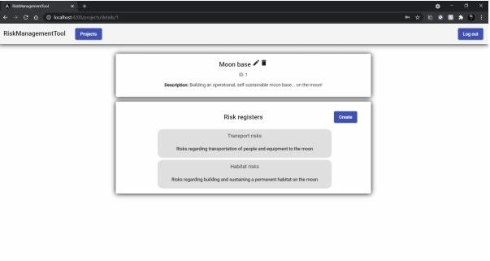
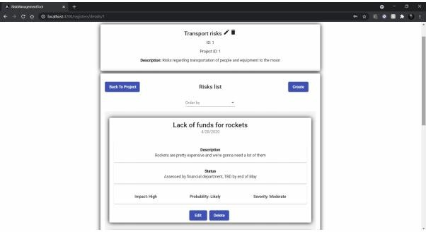
6.5) Projects Detail Page: -
Description
We can see when accessed through the projects tab the site is directed to the particular project selected by the user and from there the user can choose to edit or delete the project as well as access the creation menu for the risk register page.
6.6) Register Details Page: -
Description
When accessed the options present in the risk register tab the user is directed to the
particular field selected, as shown in the figure user selected the transport risks option and is directed towards the following page and here the user can do the same things as explained earlier which is edit, delete the register or create a risk and edit or delete from the same page.

Slide 38
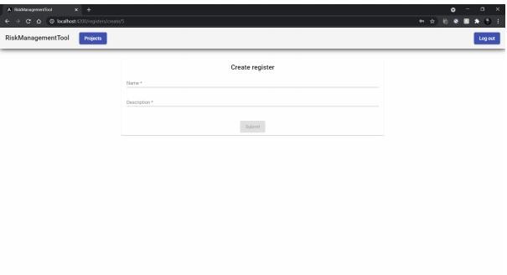
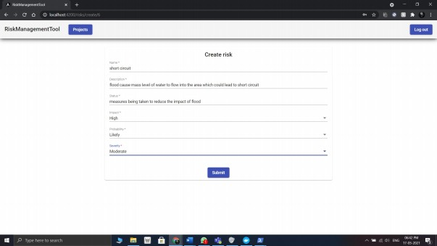
6.7) Create Register Page: -
Description
When accessed through the create option on risk register tab user is forwarded to the following tab where they have to enter the name of register and also the description of the following register.
6.8) Create Risk Page: -
Description
When the risk register is created and the user clicks on for creating the risk, they are
directed to a creation page as shown in the above figure, in the following figure we can see that the user is asked to enter the name of the risk as well as the description, status of the following risk, impact on the project the following risk is going to have, probability for the risk to occur in the project's lifetime and also the severity of the risk.

Slide 39
RESULT AND ANALYSIS
A risk management website was successfully developed consisting of an elegant frontend having fast servers at backend and cloud database. All the requirements mentioned in SRS were achieved along with the implementation of UI design which was later proposed in SDS document. The result of this phase is a web application ready to be used by teams to enhance their project management experience.

